Slide 1
DIGITAL PORTFOLIO
STUDENT NAME : SANDHIYA S
REGISTER NO. : 35224U09016
NM ID : auttvu352hc24bca111
DEPARTMENT : Bachelor of Computer Application
COLLEGE : Holy Cross Arts and Science College for Women Tirupattur
UNIVERSITY : Thiruvalluvar University

Slide 2

PROJECT TITLE : DIGITAL PORTFOLIO

Slide 3
AGENDA:
PROBLEM STATEMENT
PROJECT OVERVIEW
END USER
TOOLS AND TECHNOLOGY
PORTFOLIO DESIGN AND LAYOUT
FEATURES AND FUNCTIONALITY
BENEFITS
FUTURE SCOPE
RESULT AND SCREENSHOT
CONCLUSION
GITHUB LINK

Slide 4

PROBLEM STATEMENT:
Traditional resumes lack interactivity and visual appeal
Difficult for recruiters to evaluate candidate skills quickly
Need for a professional and attractive online portfolio
Need for a dynamic, visually appealing, and responsive platform
Individuals can present their professional profile, skills, and projects effectively.

Slide 5

PROJECT OVERVIEW:
This project is a fully responsive website developed using HTML, CSS, and JavaScript to present personal and professional information in an interactive manner. It has a multiple sections such as Home, Skills, Projects, Certifications, Education, and Contact, allowing users to showcase their work, achievements, and academic background effective. The portfolio includes a profile image, resume download option, social media links, and contact form for better engagement. Visual enhancements like a custom background image and JavaScript- powered particle animation improve the overall user experience. This project acts as an online resume, helping recruiters and clients easily evaluate skills and work samples.

Slide 6



END USER:
End users are :-
Students – Showcase projects and achievements.
Employers / Recruiters – Assess candidates easily.
Freelancers – Present their work to potential clients.
Professionals – Highlight skills and achievements.

Slide 7





TOOLS AND TECHNIQUES:
HTML5 – Website structure
CSS3 – Styling and responsive design
JavaScript – Interactive effects and animations
VS Code – Development environment
GitHub – Version control and hosting

Slide 8

PORTFOLIO DESIGN & LAYOUT:
Home Page Section: have profile picture (<img> tag), name, introduction text. Including Resume download button with <a> tag linking to PDF.
Skills Section: Create Skill Categories (Languages, Frameworks, Tools). Use CSS Grid for skill cards with icons and text.
Projects Section: Add Project Cards with title, technology used, description, and View button. Apply hover effects for interactive UI.
Certificates Section: Display course completion certificates inside styled cards.Add View buttons linked to certificate images.
Education Section: Show degree, college name, and percentage inside cards.
Contact Section: Create a contact form with input fields and submit button. Add social media links (LinkedIn, GitHub, Email).
Stylings & Animations Apply CSS for responsiveness and dark theme design. Add JavaScript particles effect for background animation.
.

Slide 9
FEATURES & FUNCTIONALITY :
Responsive Design – Works on mobile, tablet, and desktop.
Navigation Bar – Smooth scrolling between sections.
Profile & Resume – Resume download option included.
Skill Showcase – Interactive skill cards.
Projects & Certifications – Detailed portfolio presentation.
Contact Form – For user interaction.
Visual Effects – Particle animation & hover effects for better UI.

Slide 10
BENEFITS:
Professional Branding – Creates a strong personal brand with an interactive design.
interactive design.
Easy Access for Employers – Employers can view projects, skills, and certifications
anytime.
Showcase Practical Skills – Demonstrates real projects instead of just listing them
in a resume.
Interactive & Engaging – Enhances user experience with animations and responsive layout.
Improved Career Opportunities – Helps students, job seekers, and freelancers attract
more opportunities.

Slide 11
FUTURE SCOPE:
Dark/Light Theme Switch – Add user-preference theme selection.
Dynamic Content Management – Connect with a database to add/edit projects and certificates without coding.
AI-based Resume Builder – Auto-generate resumes from portfolio data.
Integration with Job Portals – Direct link to apply for jobs using the portfolio.
Analytics Dashboard – Track visitors, clicks, and downloads for better insights.
Deployment as Progressive Web App (PWA) – Make it installable like an app on mobile devices.

Slide 12
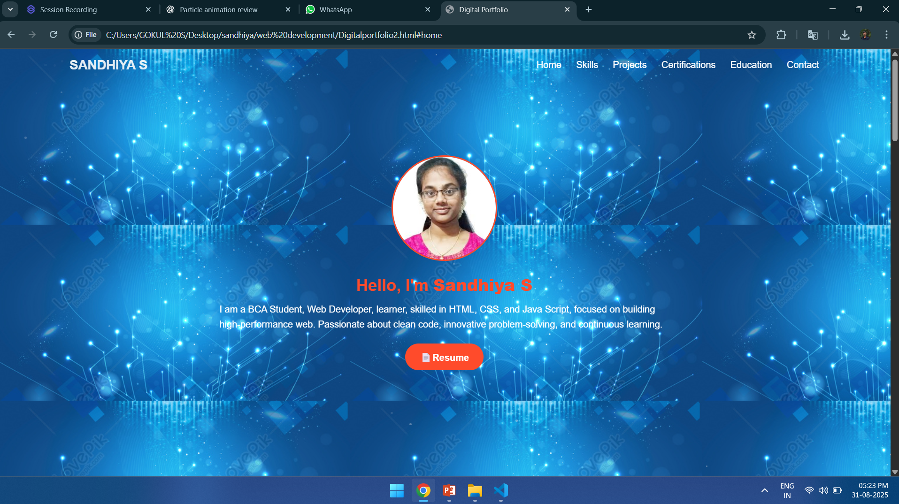
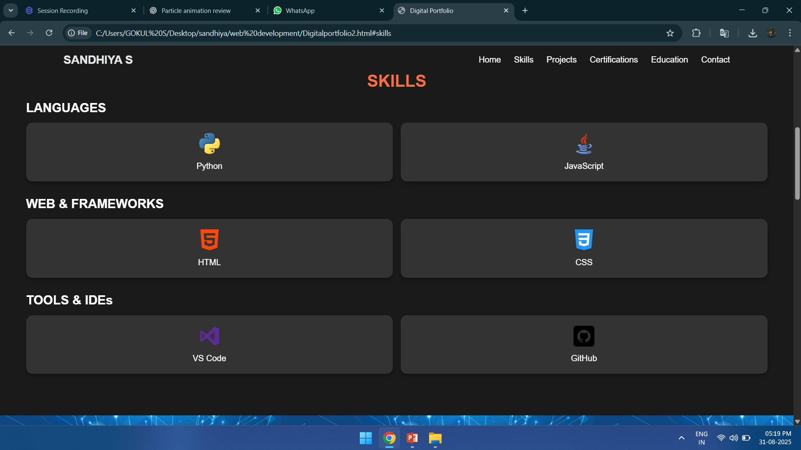
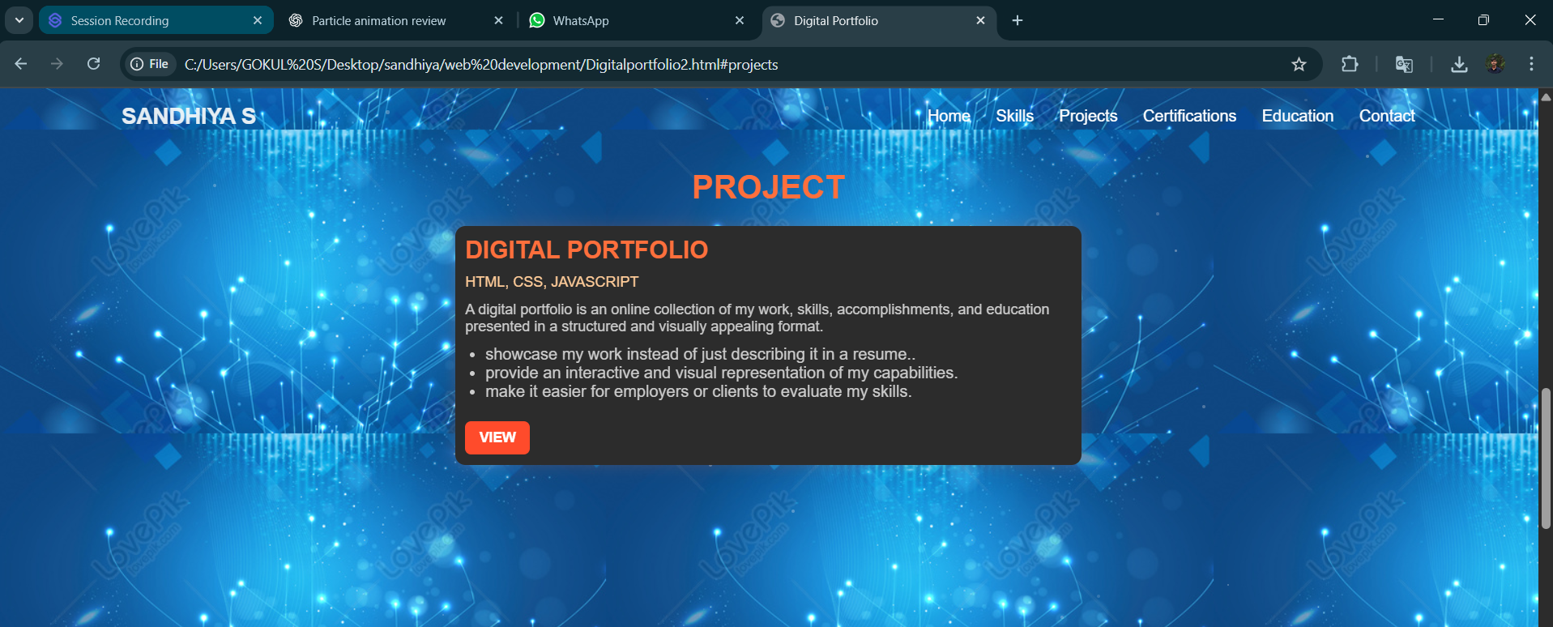
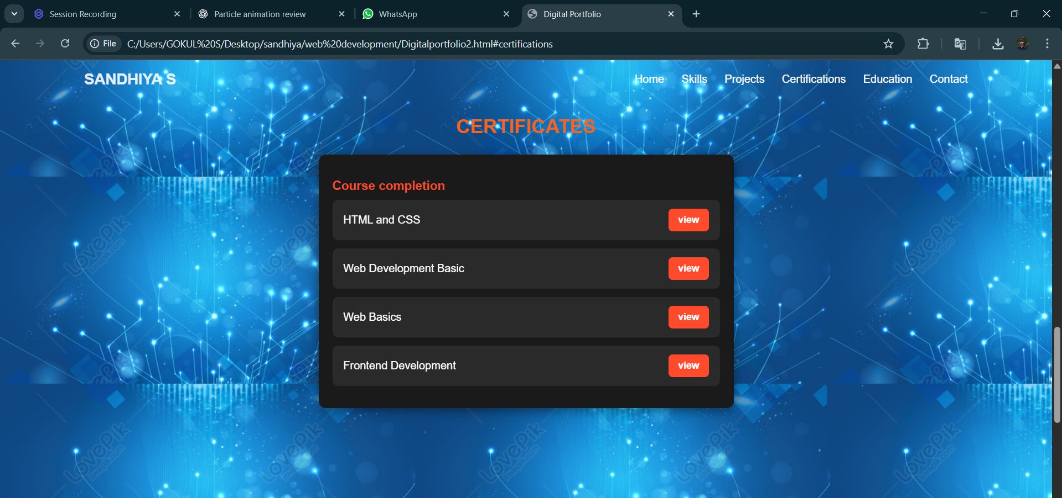
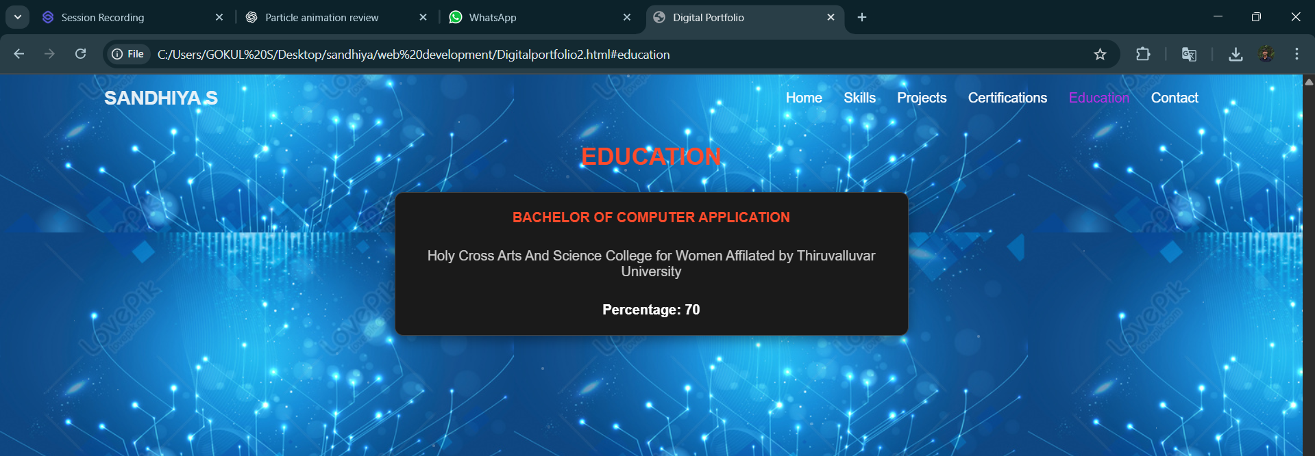
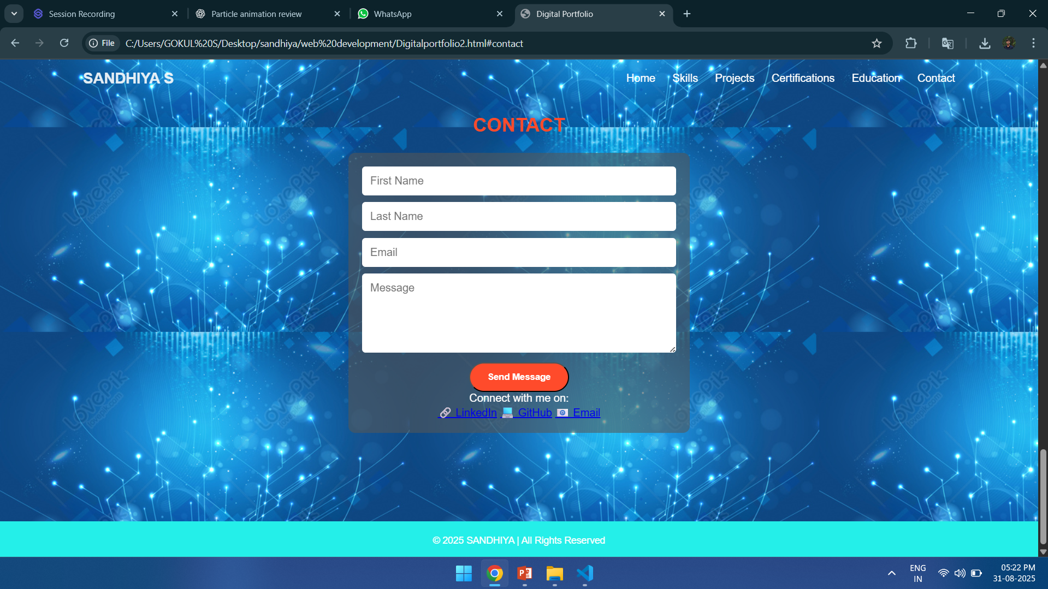
Results & Screenshots:

Slide 13
CONCLUSION:
Developed a professional digital portfolio website
Helps in personal branding and job opportunities
Future scope: Backend for form, dark mode, React-based enhancements
Interactive design, responsive layout, and visual animations.
The digital portfolio provides a modern, engaging way to present professional details instead of static resumes.
Helps students, job seekers, and freelancers to showcase their skills effectively, improving career opportunities.

Slide 14
GIT HUB LINK:
https://github.com/sandhiyas30

Slide 15
…Thank You…

